Slide 1

English for Telephoning
Class: 18C1-NNA1
Time: 14.10 – 15.40 on
Lecturer: Ms. Nguyen Thi Thanh Tu
Faculty of Foreign Languages
Ly Tu Trong College of Ho Chi Minh City
Unit 5: I’m very sorry about that.

Slide 2
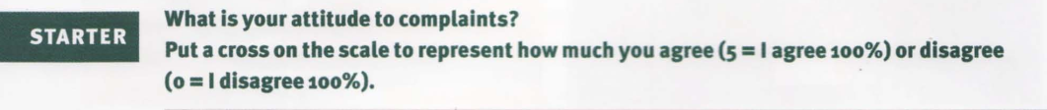
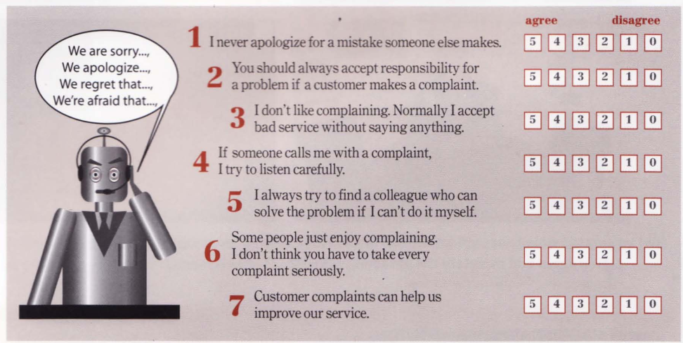

Slide 3
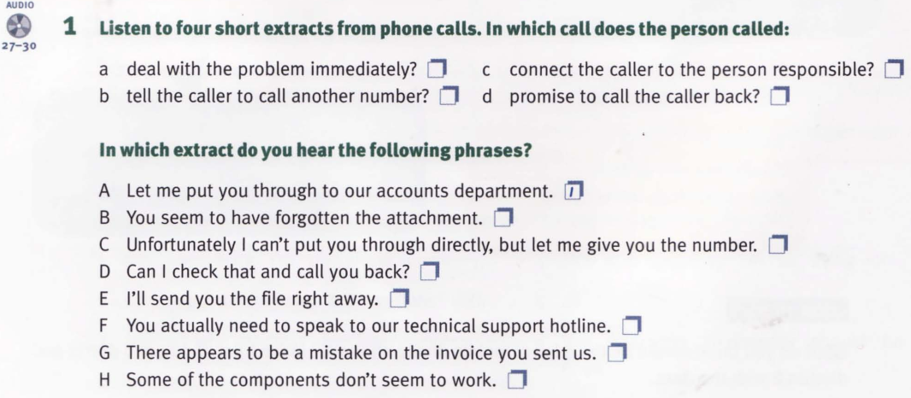

Slide 4
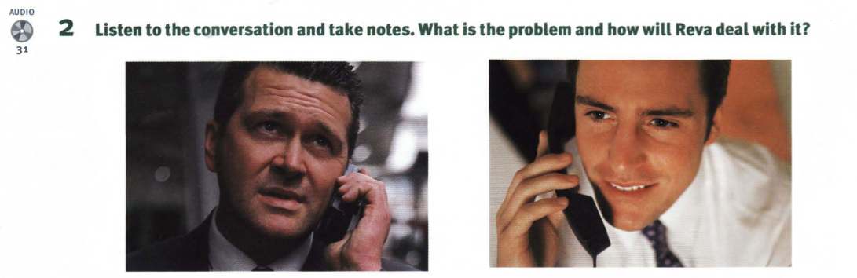

Slide 5
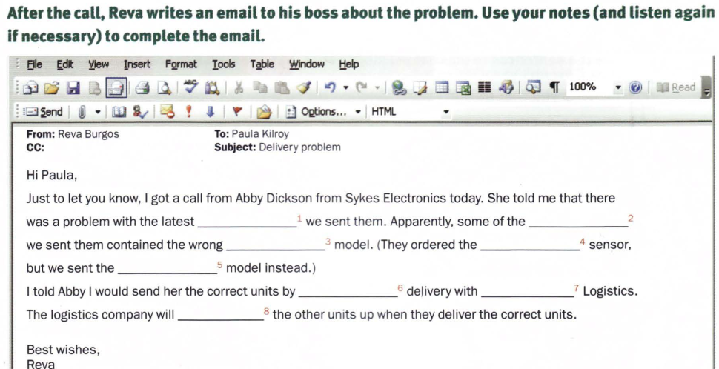

Slide 6
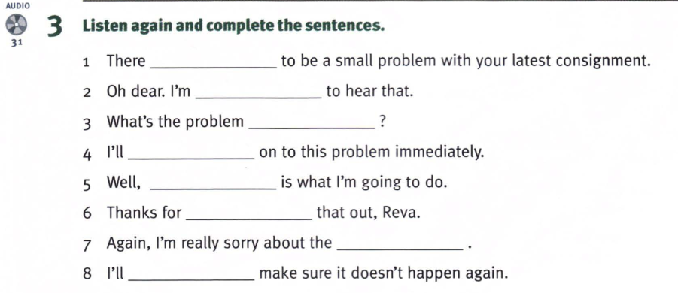
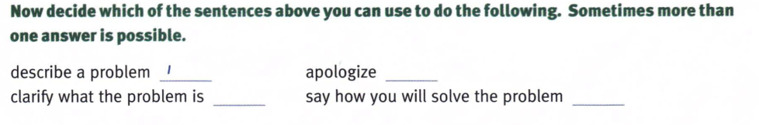

Slide 7
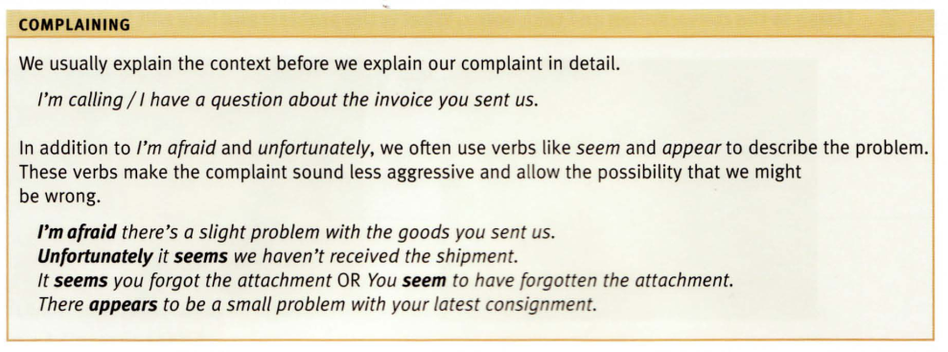

Slide 8
Homework:
After these two periods you have to learn all vocabulary.
Prepare for the rest parts of unit 5

